Slide 1


CS-2001
Data Structures
Fall 2022
AVL Trees
Mr. Muhammad Usman Joyia
National University of Computer and Emerging Sciences,
Faisalabad, Pakistan.

Slide 2
Balanced and Unbalanced BST
1
4
2
2
5
3
1
3
4
4
Is this “balanced”?
5
2
6
6
1
3
5
7
7

Slide 3
Balanced Tree
Want a (almost) complete tree after every operation
  Tree is full except possibly in the lower right
Maintenance of such as tree is expensive
  For example, insert 2 in the tree on the left and then rebuild as a complete tree
6
5
Insert 2 &
complete tree
4
9
2
8
1
5
8
1
4
6
9

Slide 4
AVL Trees – Good but not Perfect Balance
Named after Adelson-Velskii and Landis
Balance is defined by comparing the height of the two sub-trees
Recall:
  An empty tree has height –1
  A tree with a single node has height 0

Slide 5
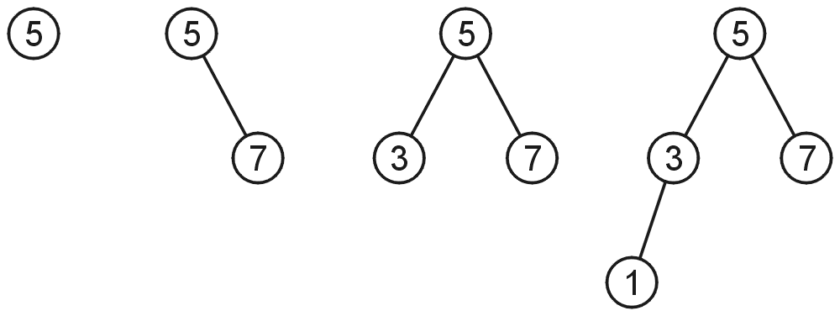
AVL Trees
A binary search tree is said to be AVL balanced if:
  The difference in the heights between the left and right sub-trees is at most 1, and
  Both sub-trees are themselves AVL trees
AVL trees with 1, 2, 3 and 4 nodes

Slide 6
AVL Trees – Example
5
7
2
8
2
8
1
4
7
1
4
3
3
5
An AVL Tree
Not an AVL Tree

Slide 7
AVL Trees – Balance Factor
An AVL tree has balance factor calculated at every node
  Height of the left subtree minus the height of the right subtree
  For an AVL tree, the balances of the nodes are always -1, 0 or 1.
Height of node = h
Balance Factor (BF) = h_{left} - h_{right}
Empty height = -1
Tree A (AVL)
Tree B (AVL)
6
height=2 BF=1-0=1
6
1
4
9
0
4
9
0
0
1
5
-1
-1
1
5
8
-1
-1
-1
-1
-1
-1
-1
-1
-1
-1
-1

Slide 8
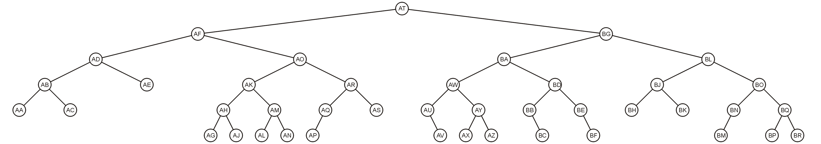
AVL Trees – Example
Here is a larger AVL tree (42 nodes)

Slide 9
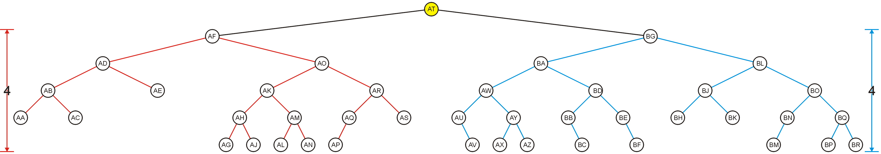
AVL Trees – Example
The root node is AVL-balanced
  Both sub-trees are of height 4 (i.e., at root BF = 0)

Slide 10
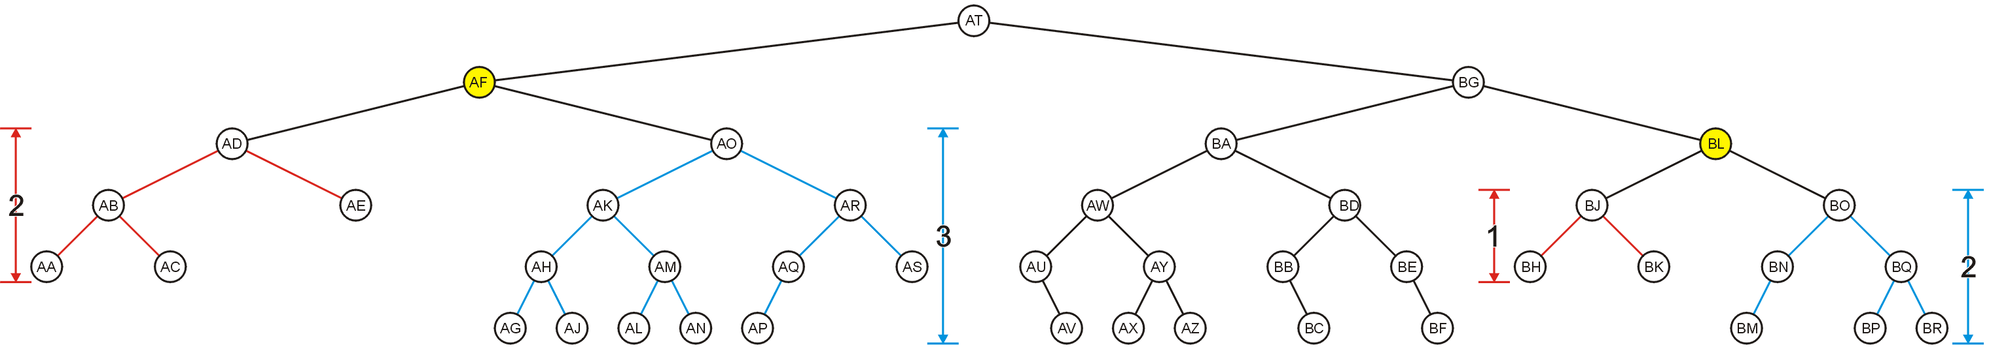
AVL Trees – Example
All other nodes (e.g., AF and BL) are AVL balanced
  The sub-trees differ in height by at most one

Slide 11
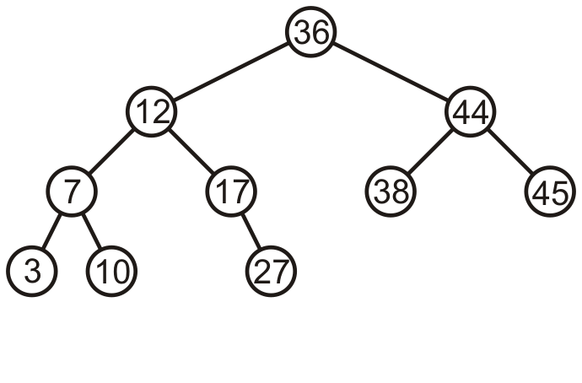
AVL Trees – Example
Consider this AVL tree

Slide 12
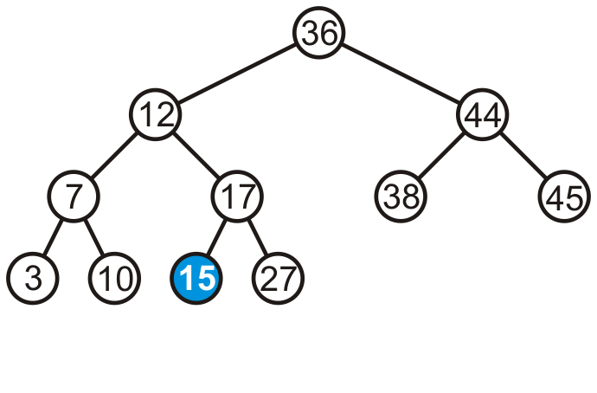
AVL Trees – Example
Consider inserting 15 into this tree
  In this case, the heights of none of the trees change
  Tree remains balanced

Slide 13
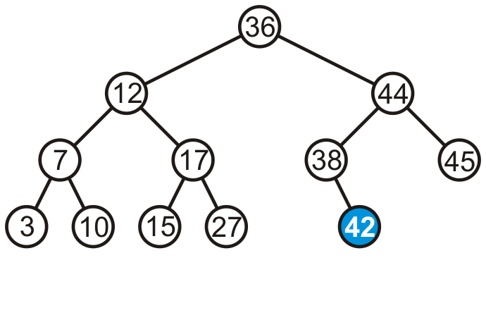
AVL Trees – Example
Consider inserting 42 into this tree

Slide 14
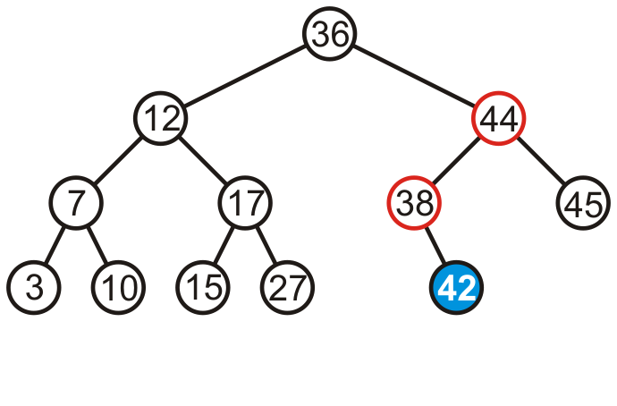
AVL Trees – Example
Consider inserting 42 into this tree
  Height of two sub-trees rooted at 44 and 38 have increased by one
  The tree is still balanced

Slide 15
AVL Trees – Example
Tree A (AVL)
Tree B (not AVL)
3
balance factor
1-(-1) = 2
6
6
2
4
9
4
9
1
-1
1
5
7
1
5
8
0
7
Height of node = h
Balance factor = h_{left}-h_{right}
Empty height = -1
Notes:
https://www.cs.usfca.edu/~galles/visualization/AVLtree.html

Slide 16
AVL Trees
To maintain the height balanced property of the AVL tree, it is necessary to perform a transformation on the tree so that
  In-order traversal of the transformed tree is the same as for the original tree (i.e., the new tree remains a binary search tree).
  perform a transformation on the tree

Slide 17
Transformation (Rotation) of AVL Trees
Insert operations may cause balance factor to become 2 or –2 for some node
Only nodes on the path from insertion point to root node have possibly change in height
Follow the path up to the root, find the first node (i.e., deepest) whose new balance violates the AVL condition
If a new balance factor (the difference h_{left}-h_{right}) is not [-1,0,1]
  Adjust tree by rotation around the node a

Slide 18
Balancing AVL Trees – Example
If a tree is AVL balanced, for an insertion to cause an imbalance:
  The heights of the sub-trees must differ by 1
  The insertion must increase the height of the deeper sub-tree by 1

Slide 19
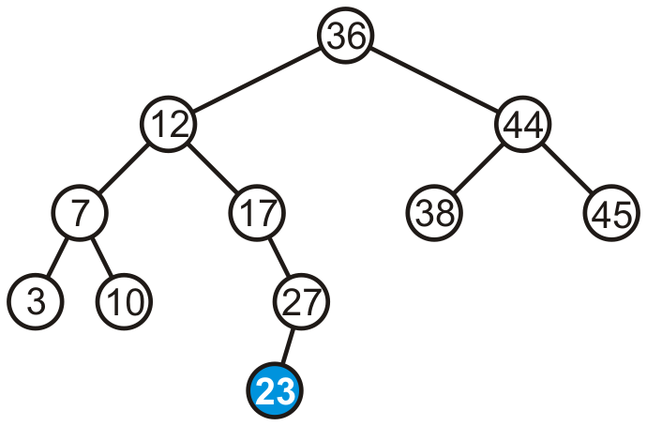
Balancing AVL Trees – Example
Suppose we insert 23 into our initial tree

Slide 20
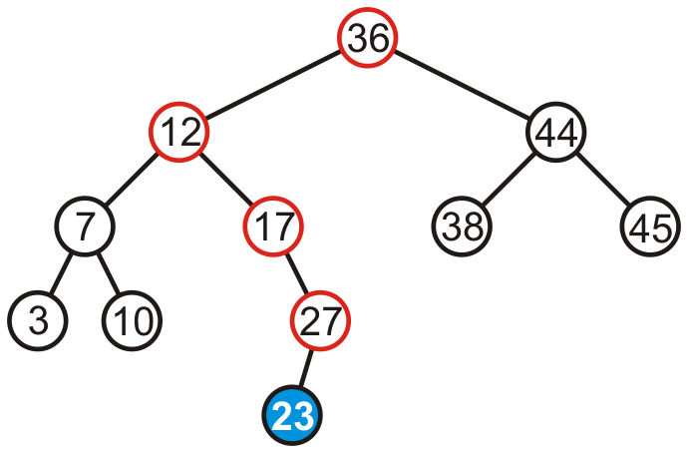
Balancing AVL Trees – Example
The heights of each of the sub-trees from the insertion point to the root are increased by one

Slide 21
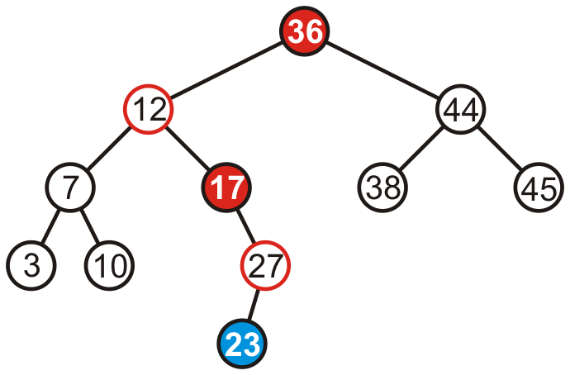
Balancing AVL Trees – Example
Only two of the nodes are unbalanced, i.e., 17 and 36
  Balance factor of 17 is -2
  Balance factor of 36 is 2

Slide 22
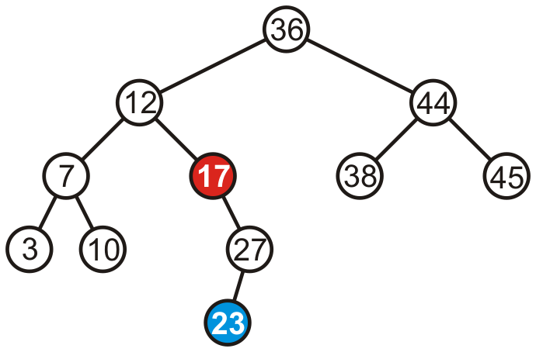
Balancing AVL Trees – Example
We only have to fix the imbalance at the lowest node

Slide 23
Fixing Imbalance By Rotation
Let the node that needs rebalancing be a
Imbalance during insertion may be handled using four cases
Outside cases (Single Rotation)
  Right rotation (case RR)
  Left rotation (case LL)
Inside cases (Double Rotation)
  Right-left rotation (case RL)
  Left-right rotation (case LR)

Slide 24
Single Rotation in an AVL Tree
2
2
6
6
1
2
1
1
4
9
4
8
0
0
1
0
0
0
0
1
5
8
1
5
7
9
0
7

Slide 25
Right Rotation (RR) in an AVL Tree
Node b becomes the new root
Node b takes ownership of node a, as it's right child
Node a takes ownership of node b's right child (or NULL if no child)
  As left child of node a
a
b
b
c
a
c

Slide 26
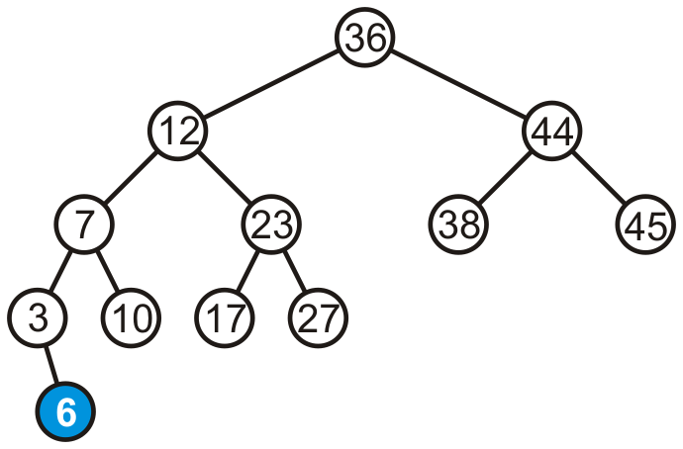
Right Rotation (RR) – Example
Consider adding 6

Slide 27
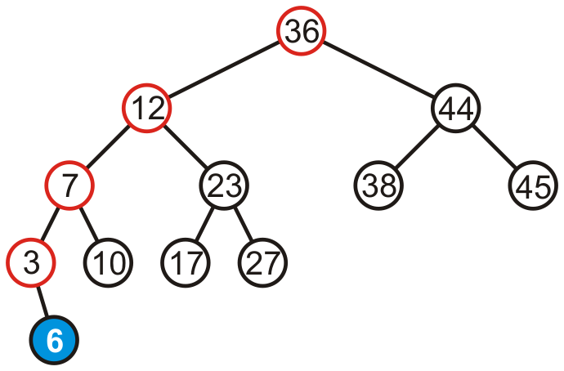
Right Rotation (RR) – Example
Height of each of the trees in the path back to the root are increased by one

Slide 28
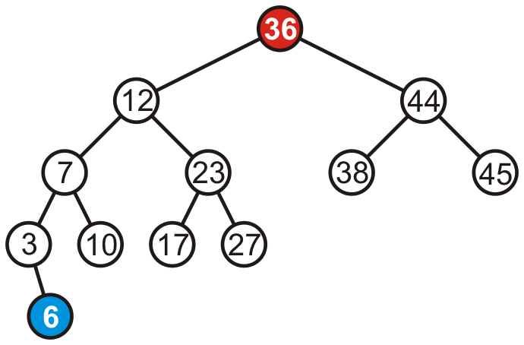
Right Rotation (RR) – Example
Height of each of the trees in the path back to the root are increased by one
  Only root node (i.e., 36) violates the balancing factor

Slide 29
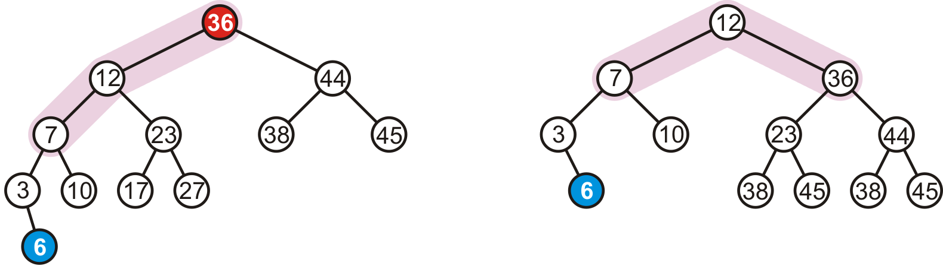
Right Rotation (RR) – Example
To fix the imbalance, we perform right rotation of root (i.e., 36)

Slide 30
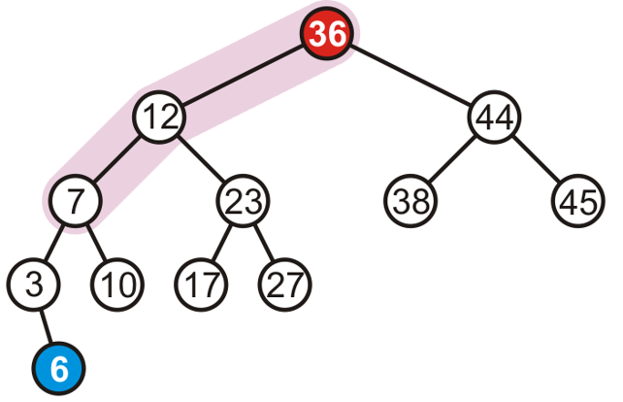
When to Perform Right Rotation (RR)
Let the node that needs rebalancing be a
Case RR
  Insertion into left subtree of left child of node a
  Left tree is heavy (i.e., h_{left}- h_{right} > [-1,0,1])

Slide 31
When to Perform Right Rotation (RR)
Let the node that needs rebalancing be a
Case RR
  Insertion into left subtree of left child of node a (RR)
  Left tree is heavy (i.e., h_{left} > h_{right} )

Slide 32
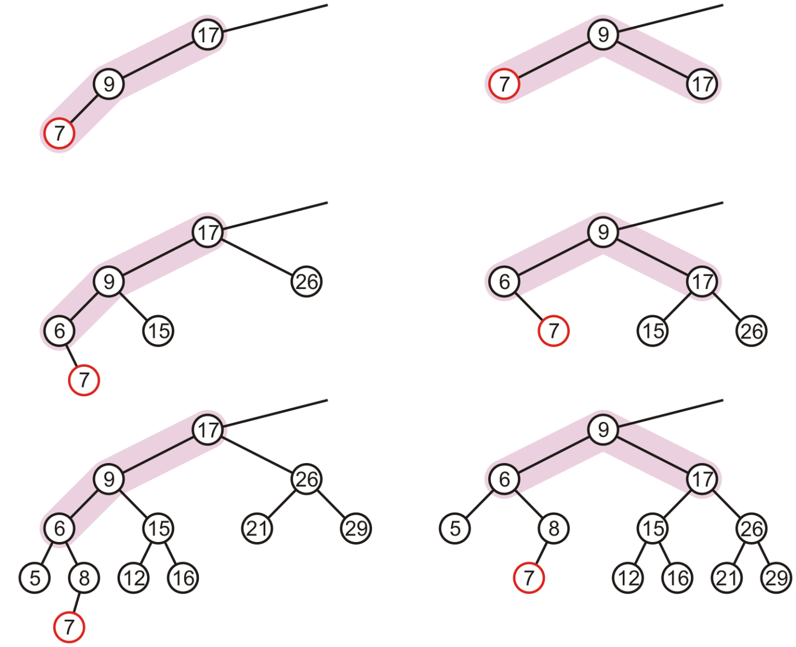
Right Rotation (RR) – Examples

Slide 33
Left Rotation (LL) in an AVL Tree
Node b becomes the new root
Node b takes ownership of node a as its left child
Node a takes ownership of node b's left child (or NULL if no child)
  As right child of node a
a
b
b
a
c
c

Slide 34
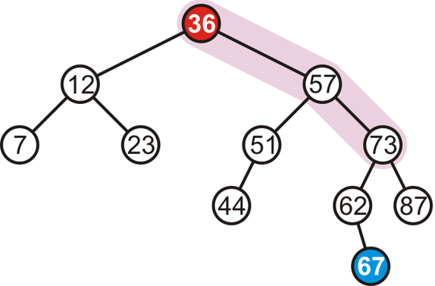
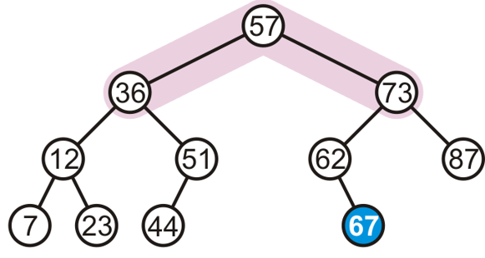
Left Rotation (LL) – Example
Consider adding 67
  To fix the imbalance, we perform left rotation of root (i.e., 36)

Slide 35
When to Perform Left Rotation (LL)
Let the node that needs rebalancing be a
Case LL
  Insertion into right subtree of right child of node a
  Right tree is heavy (i.e., h_{left} < h_{right} )

Slide 36
When to Perform Left Rotation (LL)
Let the node that needs rebalancing be a
Case LL
  Insertion into right subtree of right child of node a (LL)
  Right tree is heavy (i.e., h_{left} < h_{right} )

Slide 37
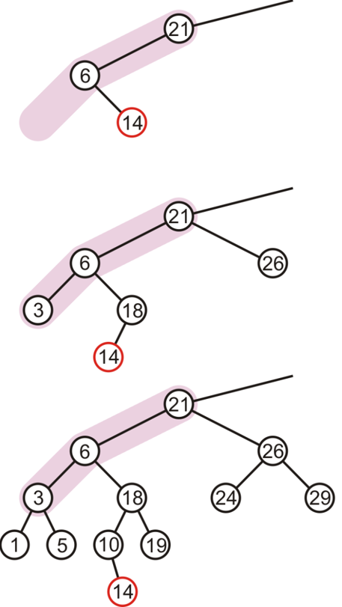
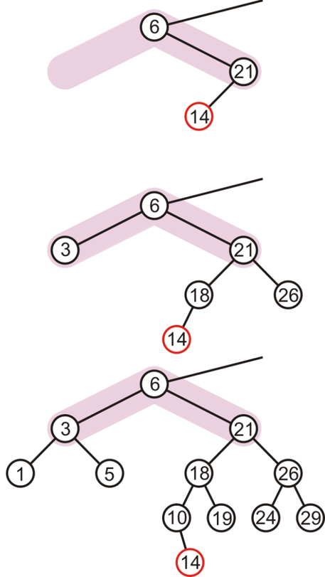
Single Rotation May Be Insufficient
The imbalance is just
shifted to the other
side

Slide 38
Right-Left Rotation (RL) or "Double Right"
c
c
b
Right
a
b
Left
a
c
b
a
Perform a left rotation on the left subtree
Node b becomes the new root
Node b takes ownership of node c as its right child
Node c takes ownership of node b's right child
  As its left child

Slide 39
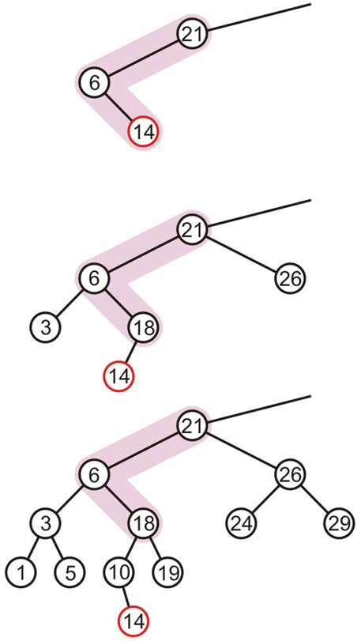
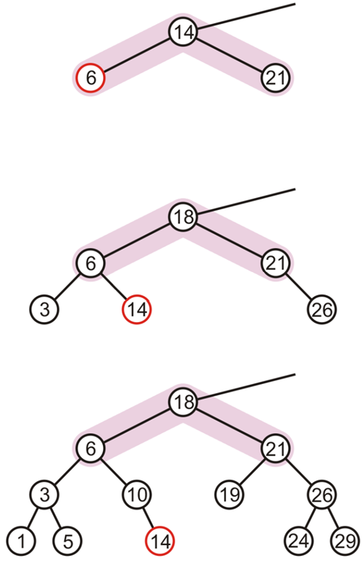
Right-Left Rotation (RL) or "Double Right" – Example

Slide 40
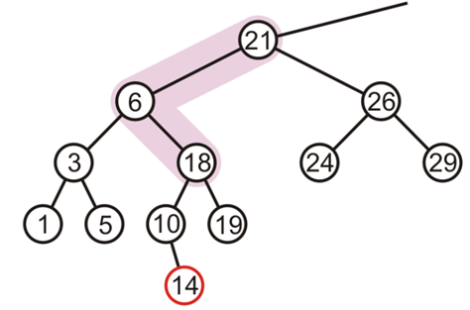
When to Perform Right-Left Rotation (RL)
Let the node that needs rebalancing be a
Case RL
  Insertion into right subtree of left child of node a

Slide 41
When to Perform Right-Left Rotation (RL)
Let the node that needs rebalancing be a
Case RL
  Insertion into right subtree of left child of node a (RL)
Left heavy
Right heavy

Slide 42
Left-Right Rotation (LR) or "Double Left"
a
a
b
Left
c
b
a
c
Right
b
c
Perform a right rotation on the right subtree
Node b becomes the new root
Node b takes ownership of node a as its left child
Node a takes ownership of node b's left child
  As its right child

Slide 43
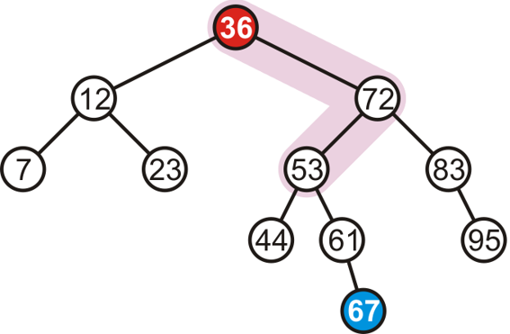
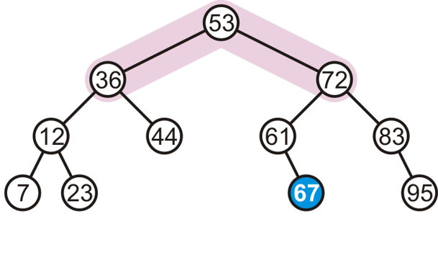
Left-Right Rotation (LR) or "Double Left" – Example
Consider adding 67
  To fix the imbalance, we perform left-right (LR) rotation of root

Slide 44
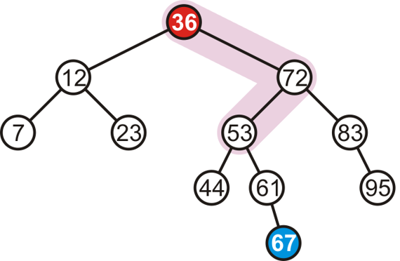
When to Perform Left-Right Rotation (LR)
Let the node that needs rebalancing be a
Case LR
  Insertion into left subtree of right child of node a

Slide 45
When to Perform Left-Right Rotation (LR)
Let the node that needs rebalancing be a
Case LR
  Insertion into left subtree of right child of node a (LR)
Right heavy
Left heavy

Slide 46
Summary: How And When To Rotate?
Let the node that needs rebalancing be a
Violation during insertion may occur in four cases
Outside cases (Single Rotation)
  Insertion into left subtree of left child of node a (case RR)
  Insertion into right subtree of right child of node a (case LL)
Case 1: RR
Case 2: LL

Slide 47
Summary: How And When To Rotate?
Let the node that needs rebalancing be a
Violation during insertion may occur in four cases
Inside cases (Double Rotation)
  Insertion into right subtree of left child of a (case RL)
  Insertion into left subtree of right child of a (case LR)
Case 3: RL
Case 4: LR

Slide 48
Summary: How And When To Rotate?
if tree is right heavy {
if tree's right subtree is left heavy {
Perform Left-Right rotation
}
else {
Perform Single Left rotation
}
}
…
…
else if tree is left heavy {
if tree's left subtree is right heavy {
Perform Right-Left rotation
}
else {
Perform Single Right rotation
}
}

Slide 49
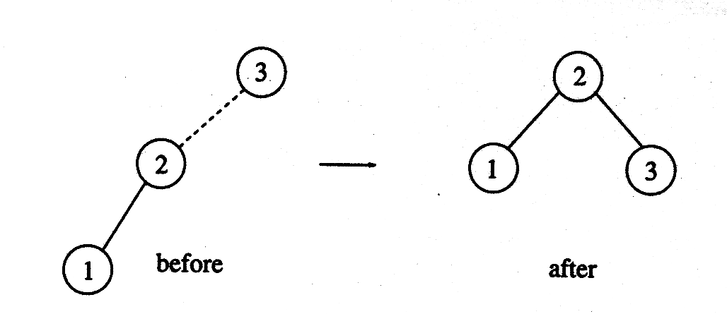
AVL Tree – Complete Example
Construct AVL Tree with the following input elements
  3, 2, 1, 4, 5, 6, 7
Insert 3, 2, 1
Insert 4, 5

Slide 50
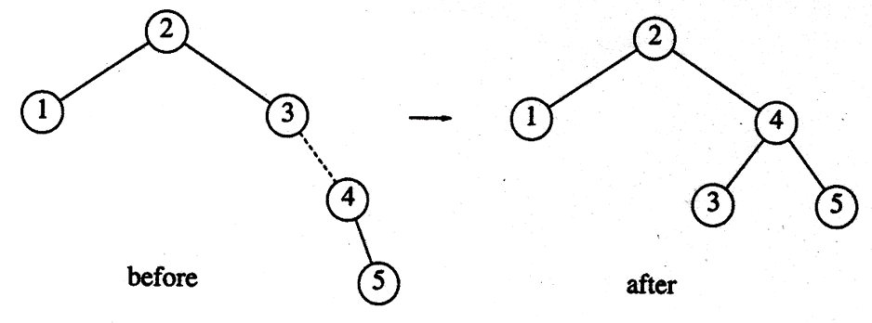
AVL Tree – Complete Example
Construct AVL Tree with the following input elements
  3, 2, 1, 4, 5, 6, 7
Insert 4, 5
Insert 6

Slide 51
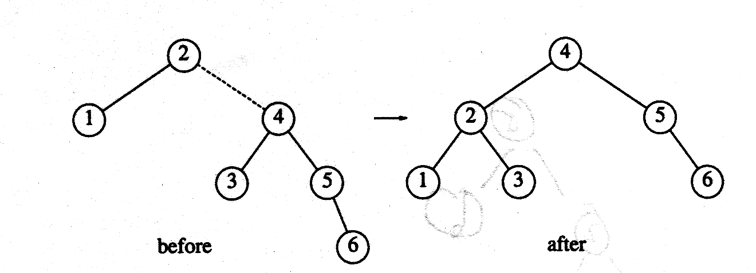
AVL Tree – Complete Example
Construct AVL Tree with the following input elements
  3, 2, 1, 4, 5, 6, 7
Insert 6
Insert 7

Slide 52
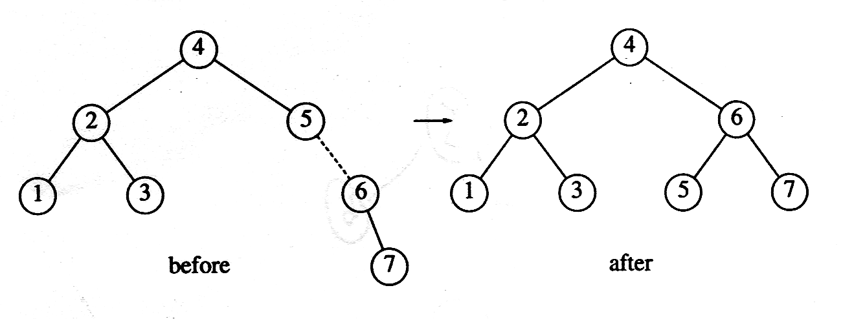
AVL Tree – Complete Example
Construct AVL Tree with the following input elements
  3, 2, 1, 4, 5, 6, 7
Insert 7

Slide 53
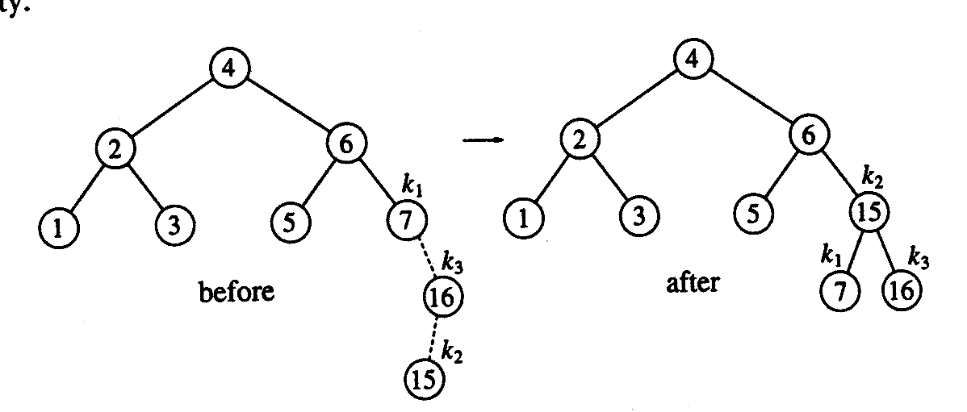
AVL Tree – Complete Example
Suppose the following elements have to be inserted further
  16, 15, 14, 13, 12, 11, 10, 8
Insert 16, 15
Insert 14
Notes:
LR Rotation → First right then left

Slide 54
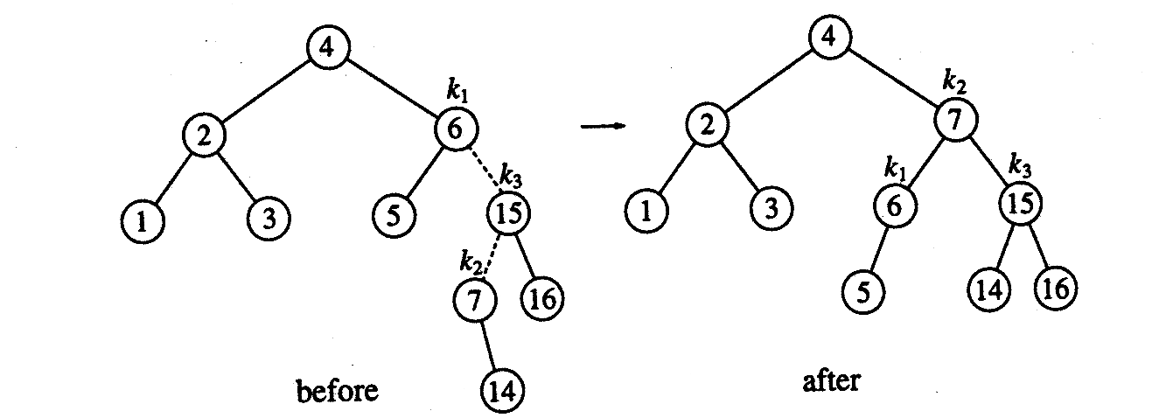
AVL Tree – Complete Example
Suppose the following elements have to be inserted further
  16, 15, 14, 13, 12, 11, 10, 8
Insert 14
Insert 13
Notes:
LR Rotation → First right then left

Slide 55
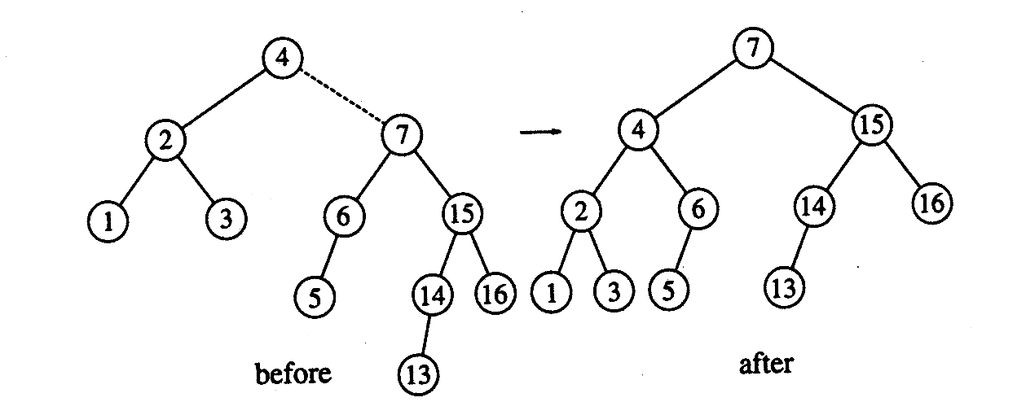
AVL Tree – Complete Example
Suppose the following elements have to be inserted further
  16, 15, 14, 13, 12, 11, 10, 8
Insert 13
Insert 12
Notes:
LL case

Slide 56
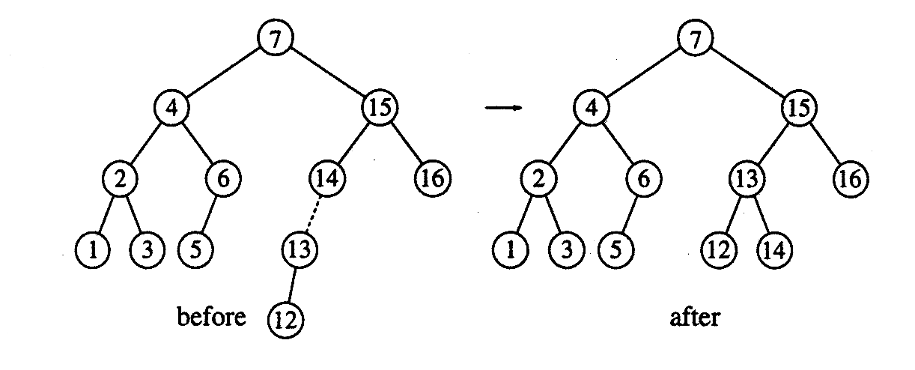
AVL Tree – Complete Example
Suppose the following elements have to be inserted further
  16, 15, 14, 13, 12, 11, 10, 8
Insert 12
Insert 11, 10
Notes:
LL case

Slide 57
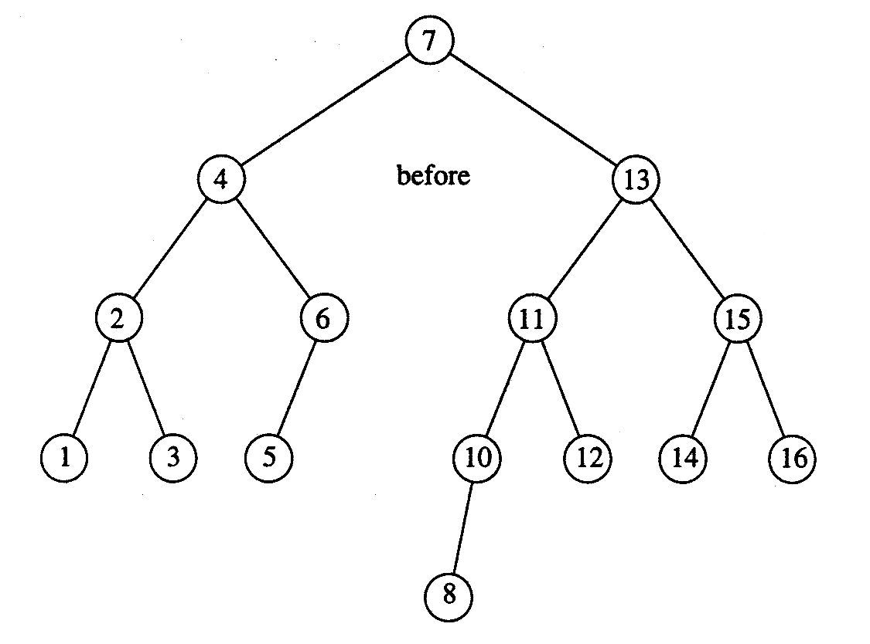
AVL Tree – Complete Example
Suppose the following elements have to be inserted further
  16, 15, 14, 13, 12, 11, 10, 8
Insert 11, 10 then 8
Notes:
LL case

Slide 58
AVL Tree Implementation

Slide 59
AVL Trees: Implementation
struct AvlNode {
ElementType Element;
AvlTree Left;
AvlTree Right;
int Height;
};
typedef struct AvlNode *Position;
typedef struct AvlNode *AvlTree;
AvlTree MakeEmpty( AvlTree T );
Position Find( ElementType X, AvlTree T );
Position FindMin( AvlTree T );
Position FindMax( AvlTree T );
AvlTree Insert( ElementType X, AvlTree T );
AvlTree Delete( ElementType X, AvlTree T );
ElementType Retrieve( Position P );

Slide 60
AVL Trees: Implementation
int Height(Position P )
{
if( P == NULL )
return -1;
else
return P->Height;
}

Slide 61
AVL Trees: Insert Function
AvlTree Insert( ElementType X, AvlTree T ) {
if ( T == NULL ) { /* Create and return a one-node tree */
T = new AvlNode;
T->Element = X;
T->Left = T->Right = NULL;
}
else if( X < T->Element ) {
T->Left = Insert( X, T->Left );
if( Height( T->Left ) - Height( T->Right ) == 2 )
if( X < T->Left->Element )
T = SingleRotateWithLeft( T ); // RR rotation
else
T = DoubleRotateWithLeft( T ); // RL rotation
}
else if( X > T->Element ) {
T->Right = Insert( X, T->Right );
if( Height( T->Right ) - Height( T->Left ) == 2 )
if( X > T->Right->Element )
T = SingleRotateWithRight( T ); // LL rotation
else
T = DoubleRotateWithRight( T ); // LR rotation
} /* Else X is in the tree already; we'll do nothing */
T->Height = Max( Height( T->Left ), Height( T->Right ) ) + 1;
return T;
}

Slide 62
AVL Trees: Insert Function
AvlTree Insert( ElementType X, AvlTree T ) {
if ( T == NULL ) { /* Create and return a one-node tree */
T = new AvlNode;
T->Element = X;
T->Left = T->Right = NULL;
}
else if( X < T->Element ) {
T->Left = Insert( X, T->Left );
if( Height( T->Left ) - Height( T->Right ) == 2 )
if( X < T->Left->Element )
T = SingleRotateWithLeft( T ); // RR rotation
else
T = DoubleRotateWithLeft( T ); // RL rotation
}
else if( X > T->Element ) {
T->Right = Insert( X, T->Right );
if( Height( T->Right ) - Height( T->Left ) == 2 )
if( X > T->Right->Element )
T = SingleRotateWithRight( T ); // LL rotation
else
T = DoubleRotateWithRight( T ); // LR rotation
} /* Else X is in the tree already; we'll do nothing */
T->Height = Max( Height( T->Left ), Height( T->Right ) ) + 1;
return T;
}
if ( T == NULL ) { /* Create and return a one-node tree */
T = new AvlNode;
T->Element = X;
T->Left = T->Right = NULL;
}

Slide 63
AVL Trees: Insert Function
AvlTree Insert( ElementType X, AvlTree T ) {
if ( T == NULL ) { /* Create and return a one-node tree */
T = new AvlNode;
T->Element = X;
T->Left = T->Right = NULL;
}
else if( X < T->Element ) {
T->Left = Insert( X, T->Left );
if( Height( T->Left ) - Height( T->Right ) == 2 )
if( X < T->Left->Element )
T = SingleRotateWithLeft( T ); // RR rotation
else
T = DoubleRotateWithLeft( T ); // RL rotation
}
else if( X > T->Element ) {
T->Right = Insert( X, T->Right );
if( Height( T->Right ) - Height( T->Left ) == 2 )
if( X > T->Right->Element )
T = SingleRotateWithRight( T ); // LL rotation
else
T = DoubleRotateWithRight( T ); // LR rotation
} /* Else X is in the tree already; we'll do nothing */
T->Height = Max( Height( T->Left ), Height( T->Right ) ) + 1;
return T;
}
else if( X < T->Element ) {
T->Left = Insert( X, T->Left );
if( Height( T->Left ) - Height( T->Right ) == 2 )
if( X < T->Left->Element )
T = SingleRotateWithLeft( T ); // RR rotation
else
T = DoubleRotateWithLeft( T ); // RL rotation
}

Slide 64
AVL Trees: Insert Function
AvlTree Insert( ElementType X, AvlTree T ) {
if ( T == NULL ) { /* Create and return a one-node tree */
T = new AvlNode;
T->Element = X;
T->Left = T->Right = NULL;
}
else if( X < T->Element ) {
T->Left = Insert( X, T->Left );
if( Height( T->Left ) - Height( T->Right ) == 2 )
if( X < T->Left->Element )
T = SingleRotateWithLeft( T );
else
T = DoubleRotateWithLeft( T );
}
else if( X > T->Element ) {
T->Right = Insert( X, T->Right );
if( Height( T->Right ) - Height( T->Left ) == 2 )
if( X > T->Right->Element )
T = SingleRotateWithRight( T ); // RR rotation
else
T = DoubleRotateWithRight( T ); // LR rotation
} /* Else X is in the tree already; we'll do nothing */
T->Height = Max( Height( T->Left ), Height( T->Right ) ) + 1;
return T;
}
else if( X > T->Element ) {
T->Right = Insert( X, T->Right );
if( Height( T->Right ) - Height( T->Left ) == 2 )
if( X > T->Right->Element )
T = SingleRotateWithRight( T ); // LL rotation
else
T = DoubleRotateWithRight( T ); // LR rotation
}
/* Else X is in the tree already; we'll do nothing */

Slide 65
AVL Trees: Insert Function
AvlTree Insert( ElementType X, AvlTree T ) {
if ( T == NULL ) { /* Create and return a one-node tree */
T = new AvlNode;
T->Element = X;
T->Left = T->Right = NULL;
}
else if( X < T->Element ) {
T->Left = Insert( X, T->Left );
if( Height( T->Left ) - Height( T->Right ) == 2 )
if( X < T->Left->Element )
T = SingleRotateWithLeft( T ); // RR rotation
else
T = DoubleRotateWithLeft( T ); // RL rotation
}
else if( X > T->Element ) {
T->Right = Insert( X, T->Right );
if( Height( T->Right ) - Height( T->Left ) == 2 )
if( X > T->Right->Element )
T = SingleRotateWithRight( T ); // LL rotation
else
T = DoubleRotateWithRight( T ); // LR rotation
} /* Else X is in the tree already; we'll do nothing */
T->Height = Max( Height( T->Left ), Height( T->Right ) ) + 1;
return T;
}
T->Height = Max( Height( T->Left ), Height( T->Right ) ) + 1;
return T;

Slide 66
AVL Trees: LL Rotation
Position SingleRotateWithRight( Position K1 ) {
Position K2;
K2 = K1->Right; // K1: node whose balance factor is violated
K1->Right = K2->Left;
K2->Left = K1;
K1->Height = Max( Height(K1->Left), Height(K1->Right) ) + 1;
K2->Height = Max( Height(K2->Right), K1->Height ) + 1;
return K2; /* New root */
}
K1
K2
20
K2
Left Rotation
40
40
K1
10
20
50
30
50
10
30
60
60

Slide 67
AVL Trees: RR Rotation
Position SingleRotateWithLeft( Position K1 ) {
Position K2;
K2 = K1->Left; // K1: node whose balance factor is violated
K1->Left = K2->Right;
K2->Right = K1;
K1->Height = Max( Height(K1->Left), Height(K1->Right) ) + 1;
K2->Height = Max( Height(K2->Left), K1->Height ) + 1;
return K2; /* New root */
}

Slide 68
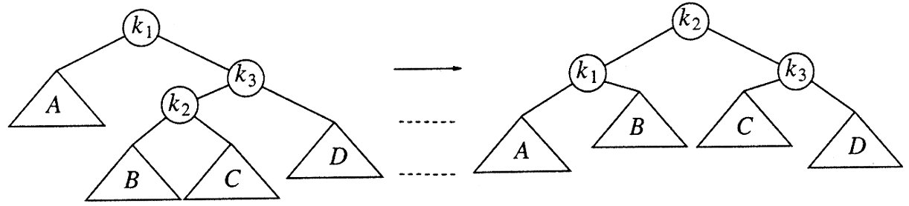
AVL Trees: LR Rotation
Position DoubleRotateWithRight( Position K1)
{
/* RR rotation between K3 and K2 */
K1->Right = SingleRotateWithLeft( K1->Right );
/* LL rotation between K1 and K2 */
return SingleRotateWithRight( K1 );
}
Single Right Rotation at K3
Single Left rotation at K1

Slide 69
LR Rotation
Adding node 22
  Requires double rotation!
40
40
20
50
20
50
10
30
60
10
30
60
25
35
25
35
22

Slide 70
LR Rotation
40
40
K1
K1
20
50
20
50
K3
K2
10
30
60
10
25
60
K2
K3
25
35
22
30
22
35

Slide 71
LR Rotation
40
40
K1
K2
20
50
25
50
K2
K1
K3
10
25
60
20
30
60
K3
22
30
10
22
35
35

Slide 72
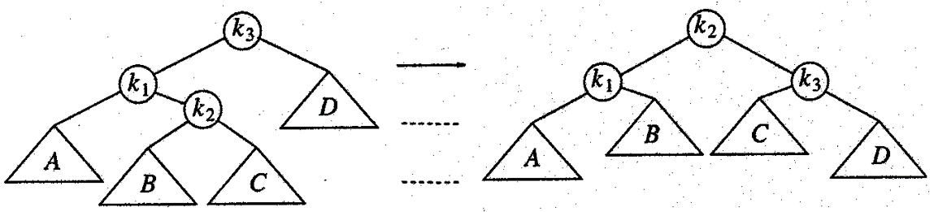
AVL Trees: RL Rotation
Position DoubleRotateWithLeft( Position K3 )
{
/* LL rotation between K1 and K2 */
K3->Left = SingleRotateWithRight( K3->Left );
/* RR rotation between K3 and K2 */
return SingleRotateWithLeft( K3 );
}
Single Left Rotation at K1
Single Right rotation at K3

Slide 73
AVL Tree Deletion

Slide 74
AVL Tree: Deletion
Goal: To preserve the height balance property of BST after deletion
Step 1: Perform BST delete
  Maintains the BST property
  May break the balance factors of ancestors!
Step 2: Fix the AVL tree balance constraint
  Perform transformation on the tree by means of rotation such that
    BST property is maintained
    Transformation fixes any balance factors that are < -1 or > 1

Slide 75
AVL Tree: Deletion
BST deletion breaks the invarialants of AVL tree
7
7
Delete(9)
4
9
4
3
3
NOT an AVL tree!

Slide 76
AVL Tree: Deletion
BST deletion breaks the balance factors of incestors
7
0
1
7
1
Delete(3)
4
9
0
1
4
9
1
0
0
0
3

Slide 77
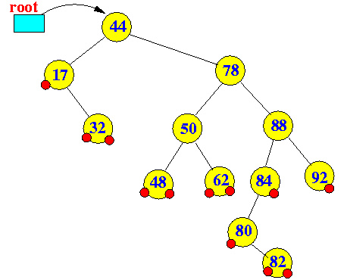
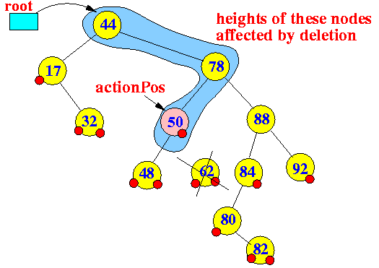
AVL Tree: BST Deletion
Case 1: Node to be deleted has degree 0 (i.e., leaf node)
  Consider deleting node containing 62
Action position: Reference to parent node from which a node has been physically removed
  First node whose height may be changed by deletion

Slide 78
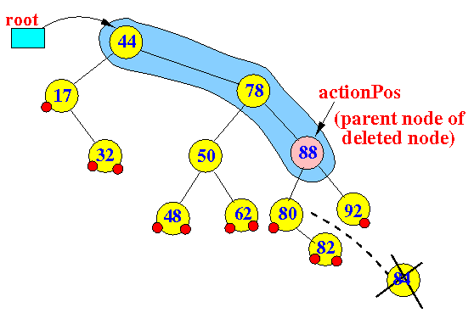
AVL Tree: BST Deletion
Case 2: Node to be deleted has degree 1 (i.e., node with one child)
  Consider deleting node containing 84

Slide 79
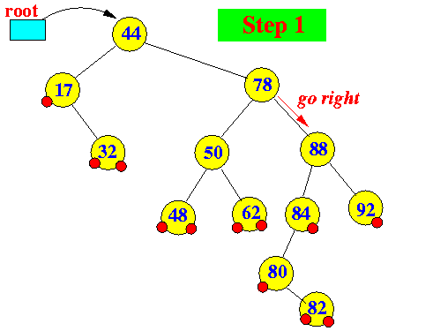
AVL Tree: BST Deletion
Case 3: Node p to be deleted has two children (i.e., degree 2)
  Replace node p with the minimum object in the right subtree
  Delete that object from the right subtree
  Consider deleting node containing 78

Slide 80
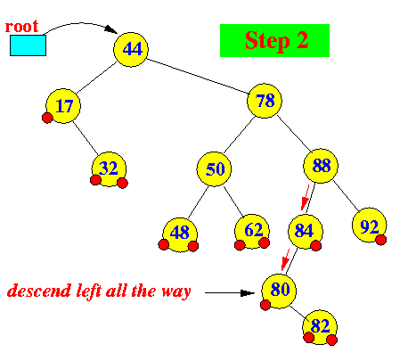
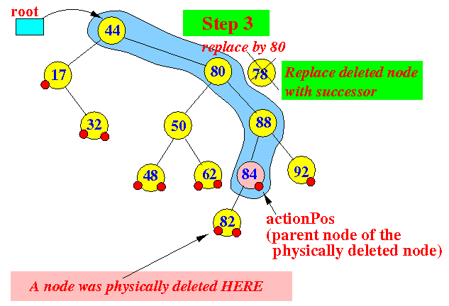
AVL Tree: BST Deletion
Case 3: Node p to be deleted has two children (i.e., degree 2)
  Replace node p with the minimum object in the right subtree
  Delete that object from the right subtree
  Consider deleting node containing 78

Slide 81
AVL Tree Deletion
After removing a child, delete must check for imbalance
  Similar to insert operation
Rotations can be used to re-balance an out-of-balanced AVL tree
  LL, RR, LR and RL rotations

Slide 82
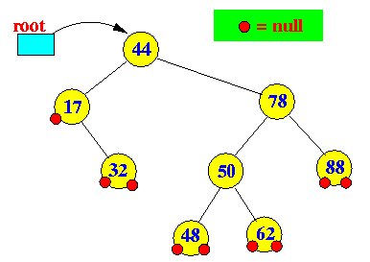
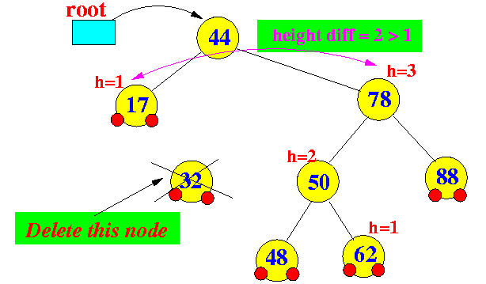
AVL Tree Deletion: Example
Deleting a node from an ALV tree can cause imbalance
  Consider deleting node 32

Slide 83
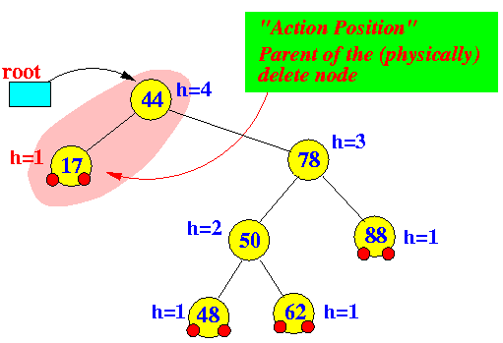
AVL Tree Deletion: Example
The balance factor changes at only nodes between the root and the parent node of the physically deleted node
  Starting at the action position find the first imbalanced node

Slide 84
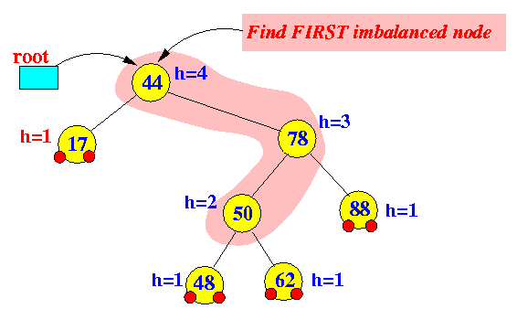
AVL Tree Deletion: Example
Perform rotation using shaded nodes
  Node a is the first imbalanced node from the action position
  Node c is the child node of node a that has the higher height
  Node b is the child node of node b that has the higher height
a
c
b

Slide 85
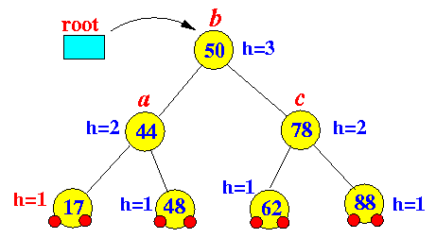
AVL Tree Deletion: Example
The tree after LR rotation

Slide 86
AVL Tree Deletion: Multiple Imbalance
The imbalance at the first imbalance node due to a deletion operation can be restored using rotation
  Resulting subtree does not have the same height as the original subtree !!!
  Nodes that are further up the tree may require re-balancing
Deleting a node may cause more than one AVL imbalance !!!
Unfortunately, delete may cause O(h) imbalances
  Insertions will only cause one imbalance that must be fixed

Slide 87

AVL Tree Deletion: Example
Consider the following AVL tree
Original height of the subtree rooted at 75 is 2

Slide 88


AVL Tree Deletion: Example
Node with value 80 is deleted
  The imbalance is on left-left subtree
  Imbalance can be fixed using RR rotation

Slide 89

AVL Tree Deletion: Example
Node 50 requires re-balancing
  The imbalance is on left-left subtree
  Imbalance can be fixed using RR rotation – Home work!!
Resultant height of the subtree is 1

Slide 90

AVL Tree Deletion: Example
Consider the following AVL tree
  Suppose node with value 1 is deleted

Slide 91

AVL Tree Deletion: Example
While its previous parent, 2, is not unbalanced, its grandparent 3 is
  The imbalance is in the right-right subtree

Slide 92

AVL Tree Deletion: Example
While its previous parent, 2, is not unbalanced, its grandparent 3 is
  The imbalance is in the right-right subtree
  Imbalance can be fixed using LL rotation

Slide 93

AVL Tree Deletion: Example
The subtrees of node 5 is now balanced
Recursing to the root, however, 8 is also unbalanced
  The imbalance is in right-left subtree

Slide 94

AVL Tree Deletion: Example
The node with value 8 is unbalanced
  The imbalance is in right-left subtree
  LR rotation can fix imbalance

Slide 95

AVL Tree Deletion: Example
Root 21 is still imbalanced
  The imbalance is in right-right subtree

Slide 96

AVL Tree Deletion: Example
Root 21 is still imbalanced
  The imbalance is in right-right subtree
  LL rotation can fix the imbalance

Slide 97

Any Question So Far?

